Slide 1

REVIVE KERALA 2020
Rehabilitation and recovery program
Covid-19 pandemic
July
2020

Slide 2

BUSINESS CASE
In the state of Kerala, India find the best suitable location for the establishment of a Medical Rehabilitation centre especially due to the covid-19 pandemic.

Slide 3

DATA COLLECTION
Data Requirements | Source | Relevance
Cumulative summary district wise | Directorate of health service, Kerala | Visualizing most affected regions
Phsycosocial support data | Directorate of health service, Kerala | Find order of districts needing mental support
LSG’s needing special attention | Directorate of health service, Kerala | Identifying hotspots and ordering districts with respect to count
Venues nearby hotspots | Foursquare API | Spotting best location for Rehab

Slide 4
METHODOLOGY
EXPLORATORY DATA ANALYSIS
District wise breakdown
ML ALGORITHM
Model deployment
RESULT
Phsycosocial support needed
Hotspots
Hospitals nearby
Inferential analysis

Slide 5
TECHNOLOGY USED
Python
Google colab
IBM Watson Studio
Tableau
Github
Pandas
Numpy
Geocode
Matplotlib
Folium
Foursquare API

Slide 6
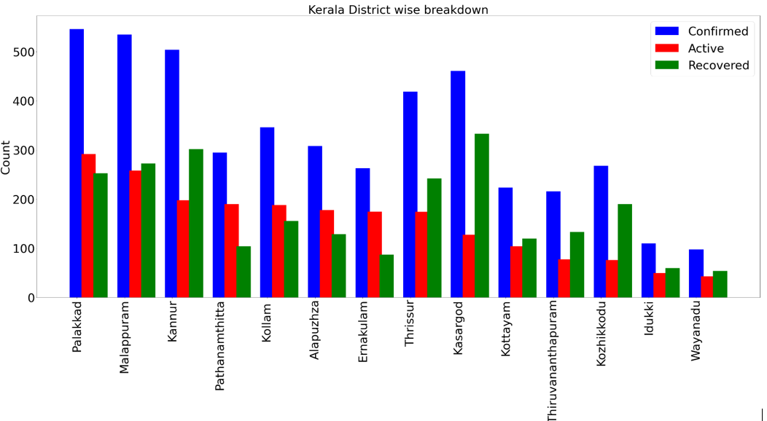
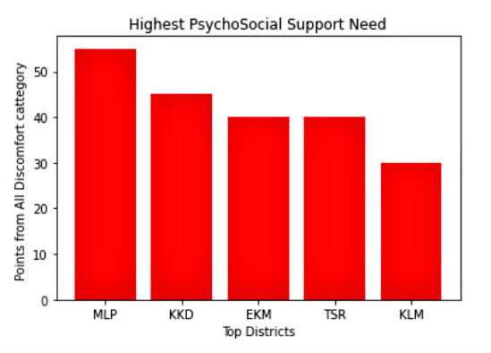
VISUALIZING DATASETS

Slide 7
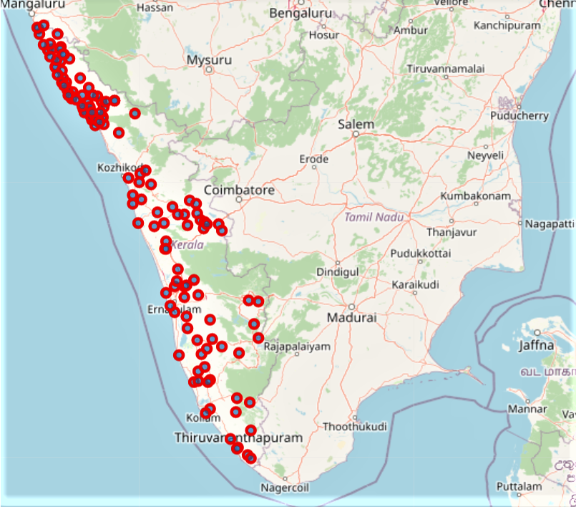
KERALA HOTSPOTS ON MAP
Using python folium library.
Northern districts are highly affected.

Slide 8
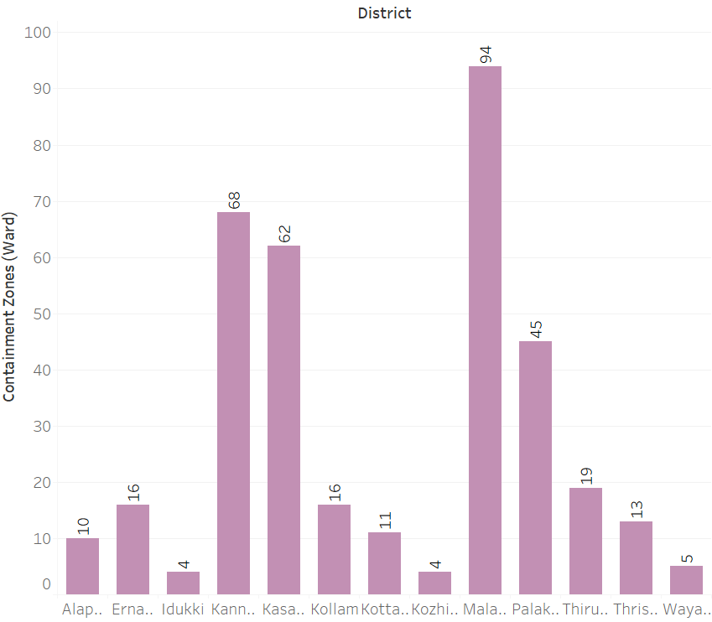
District wise count of Hotspots
Malappuram district had the highest number of hotspots.

Slide 9
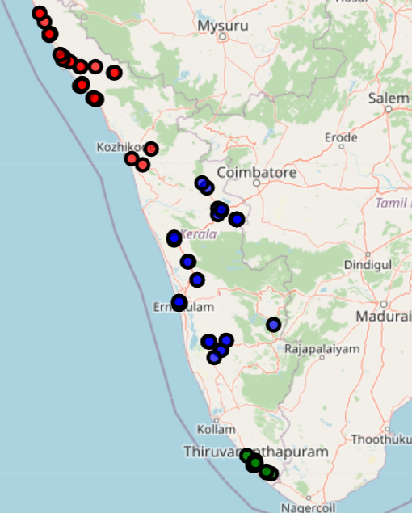
CLUSTERING MODEL
Cluster 0 : highest number of hospitals in the neighbourhood
Cluster 1 : lowest number of hospitals in the neighbourhood
Cluster 2 : moderate number of hospitals in the neighbourhood
In red ,green and blue respectively.

Slide 10
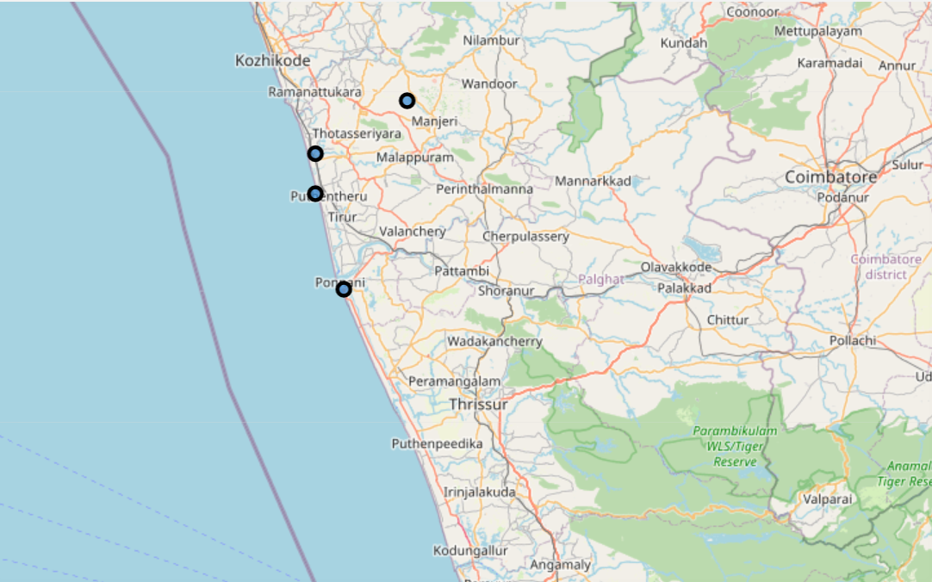
CONCLUSION
From the EDA and after the model deployment, cluster 0 was chosen to be the best cluster and Malappuram district proved to be the best location for solving the business case put forward.

Slide 11
FUTURE RESEARCH
Extend the data analysis to include more relevant data like, foreign return emigrants, covid special treatment hospitals
Data regarding the top facilities needed for a Rehab
Provide a portal with dashboard to find data specific to each district

Slide 12
GITHUB URL
The link to Github containing the code:
https://github.com/aminafysel/IBM-COURSERA-CAPSTONE-PROJECT/blob/master/IBM%20Capstone%20final%20project.ipynb

Slide 13

THANK
YOU!
Amina Fysel

